Slide 2
gRPC with .NET in Production
How Namely uses gRPC with .NET
Steve Ognibene
CodeCamp NYC 2019

Slide 3
Who has used JSON in production?
Who has used gRPC in production?
Who has tried gRPC in any context?
How do we say gRPC?

Slide 4

Steve Ognibene
Working with .NET since early 2000’s
SQL Server and VB since the ‘90s
Pluralsight author on TypeScript
Twitter/GitHub: nycdotnet

Slide 5

Namely
gRPC in production for about two years
Common protorepo describing ~ 90 services
Services implemented in Go, Ruby, Kotlin, C#

Slide 6
What is gRPC?
A high-performance, open-source, universal RPC framework
RPC
universal

Slide 7
RPC: Remote Procedure Call
Calling a function on another computer
Why would you want to do that?
What are the downsides?

Slide 8
gRPC is Universal
What does that mean?
Based on HTTP/2 – broad platform support, headers, trailers, streaming
Cross-platform, cross-language

Slide 9
Protocol Buffers
Google’s language-neutral, platform-neutral, extensible mechanism for serializing structured data

Slide 10
Protocol Buffers
Similar job to JSON, but:
Efficient (space and time) binary format
Strongly-typed*
Established schema evolution rules
*types not included with serialized messages

Slide 11
Language Neutral?
Implementations of protobuf in many popular languages
Downside: lowest common denominator
Upside: forced simplicity

Slide 12
Platform Neutral?
Any OS / Any bitness
Any performance level
Efficient binary protocol – cheap to serialize/deserialize

Slide 13
Extensible
Reflection on Metadata
Language-specific ergonomics

Slide 14
Structured Messages
Strongly-typed Services and Messages
Fundamental data types
Well-known types (dates, money, etc.)
Encourages backward and forward compatibility

Slide 15
Protobuf & Serialization Demo

Slide 16
Protobuf vs. Minified JSON
60% Savings
31 bytes – not really readable
42% Savings
46 bytes – semi-readable
78 bytes – very-readable

Slide 17
gRPC & Protobuf
HTTP/2-based
Fast
Well-understood
Headers, Trailers
Request/Response, Bi-directional Streaming
Protobuf
Efficient binary protocol
Any platform
Structured and forward and backward compatible

Slide 18
gRPC Service and Client Demo

Slide 19
Protorepo Recommendations
Establish a single repository for all protos.
Make a folder per service with service.proto; feel free to use additional proto files.
All code bases with protos have protorepo as submodule.
Don’t mix messages between services; when absolutely required, use a shared or well-known message folder.
Use the well-known types when available.
UUIDs are strings – sorry. Be sure to always make them lower-case.

Slide 20
Protorepo Recommendations (cont’d)
Don’t check in your compiled protos. (.gitignore, etc.)
Building the protos required for a service should be one command and documented in the repository readme.
Pick and choose what your service needs – don’t just compile *.proto.
Document with lots of comments!!! No more valuable PR than comments in protorepo.
Be mindful of forward- and backward-compatibility
Use [deprecated] tags.
Use “.internal” packages for app-specific serialized protos.

Slide 21
Protobuf 3
Numbered fields
Simple data types
All fields are optional
Use comments liberally
Message names should be CamelCase
Enum cases have the enum name at start in ALL_CAPS_WITH_UNDERSCORE. Zero should be UNSPECIFIED.

Slide 22
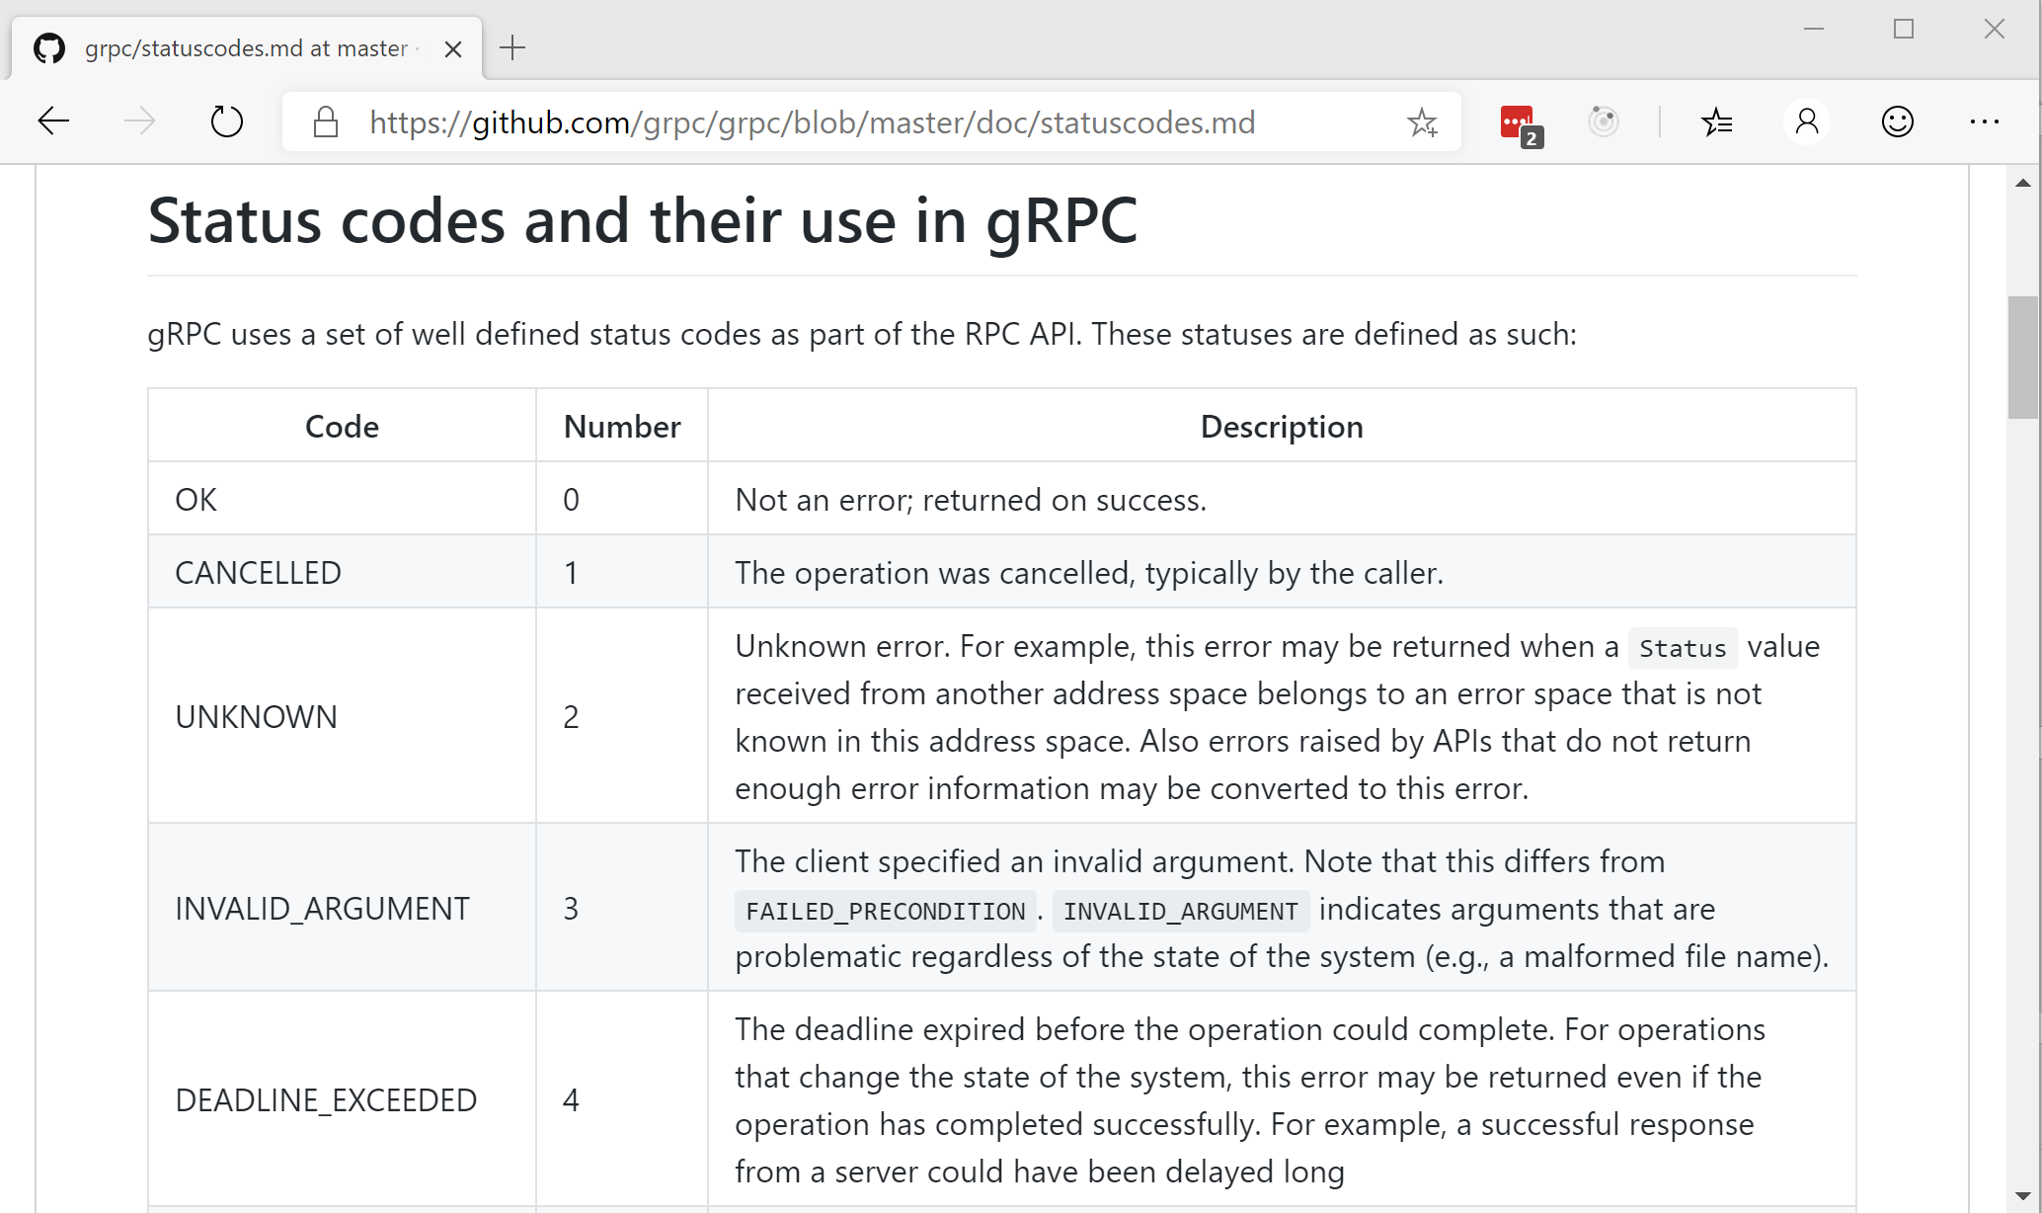
Error handling in gRPC

Slide 23
Interceptors
Middleware that affect how:
Servers handle incoming requests
Clients handle outgoing requests
Auth Injecting interceptor (“s”)
Context propagation & Header-forwarding interceptors
Instrumenting/tracing interceptors
Retrying interceptors

Slide 24
Integration with ASP.NET Core 3.0
With .NET Core 3.0, there is a new native gRPC implementation
Worth investigating if you’re new to gRPC and are very familiar with WebAPI

Slide 25
.NET Core 3.0 gRPC
Demo

Slide 26
Wrap-up
gRPC is: Super fast
Strongly typed
Space efficient – memory, storage, bandwidth
Standards-based – protobuf, HTTP/2
Flexible – interceptors, forward and backward compatibility,
multi-platform, multi-language
Microsoft is taking gRPC seriously. Worth investigating if you’re all-in on microservices and the above appeals to you.

Slide 27

Thank You!

Slide 28
Additional Links
https://developers.google.com/protocol-buffers/
https://developers.google.com/protocol-buffers/docs/style
https://grpc.io/
https://github.com/grpc/grpc-dotnet
https://github.com/namely/docker-protoc
https://github.com/nycdotnet/CodeCamp2019

